Slide 1

HTML
The Structure of Web page
HTML stands for Hypertext Markup Language. It's a programming language that's used to create web pages. HTML is made up of tags and attributes that tell a browser how to display a web page's content.
It’s also worth noting that HTML is not considered a programming language as it can’t create dynamic functionality, although it is now considered an official web standard. The World Wide Web Consortium (W3C) maintains and develops HTML specifications, along with providing regular updates.

Slide 2
Creating a simple web Page.
<!DOCTYPE html>
<html>
<head>
<title>first web page</title>
</head>
<body>
<h1>This is a heading</h1>
<p>My paragraph</p>
</body>
</html>
Specifies this is an html doc
Root of an html page
Contains page metadata
Contains title
The main body of the page(rendered by the browser)
Closing body tag

Slide 3
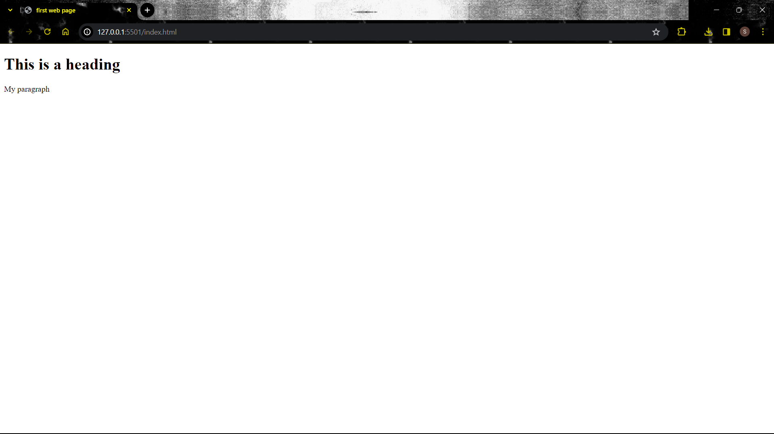
Result

Slide 4
Points to know: -
head and body tags are the children of HTML tag.
Most of the HTML tags have opening and closing tags with content in between opening and closing tags.
Some tags have no content. These are called empty elements e.g. <br>, <hr>.
We can use either .htm or .html extension.
HTML is a case-insensitive language. This means <H1> and <h1> are the same.
You can use the “Inspect” or “View Page Source” option from Chrome to look into a website’s HTML code.
HTML Element = Opening tag + Content + Closing tag
Comments in HTML: -
Comments in HTML are used to mark the text which should not be parsed. They help document the source code.
<!-- HTML comment -->

Slide 5
HTML Attributes: -
HTML attributes provide additional information about HTML elements.
All HTML elements have attributes.
They are always defined in the start tag.
They usually come in name and value pair: e.g. name=“value”.
The href attribute: -
The <a> tag defines a hyperlink. The href attribute specifies the URL of the page the link goes to.
The src attribute: -
The <img> tag is used to embed an image in an HTML page. The src attribute specifies the path to the image to be displayed.
The alt attribute: -
The required alt attribute for the <img> tag specifies an alternate text for an image if the image for some reason cannot be displayed. This can be due to a slow connection, an error in the src attribute, or if the user uses a screen reader.

Slide 6
The style attribute: -
The style attribute is used to add inline CSS to an element, such as color, font, size,
and more.
Block-level elements:-
A block-level element always starts on a new line, and the browsers automatically add some space (a margin) before and after the element.
Inline-level elements:-
An inline element does not start on a new line. An inline element only takes up as much width as necessary.
HTML Tags: -
The heading tag.
Heading tag is used to mark headings in html. From h1 to h6, we have tags for the most important to the least important. Search engines use the headings to index the structure and content of your web pages.

Slide 7
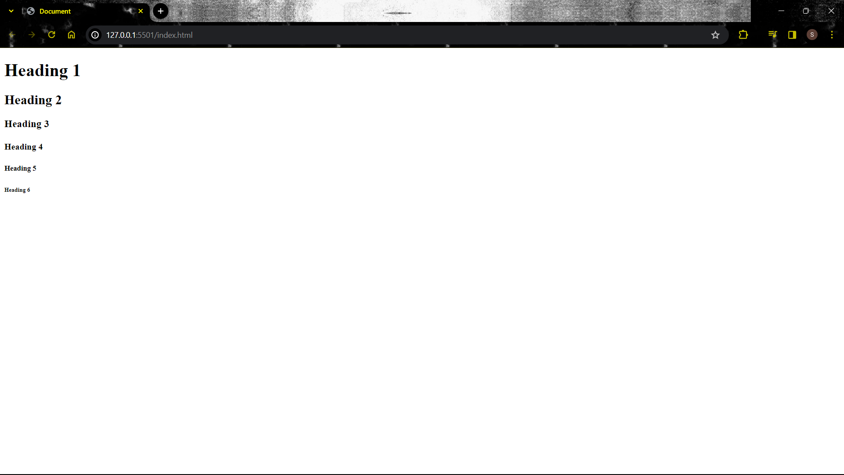
<!DOCTYPE html>
<html>
<head>
<title>Document</title>
</head>
<body>
<h1>Heading 1</h1>
<h2>Heading 2</h2>
<h3>Heading 3</h3>
<h4>Heading 4</h4>
<h5>Heading 5</h5>
<h6>Heading 6</h6>
</body>
</html>
NOTE: - We should not use HTML headings to make
text thick or bold.

Slide 8
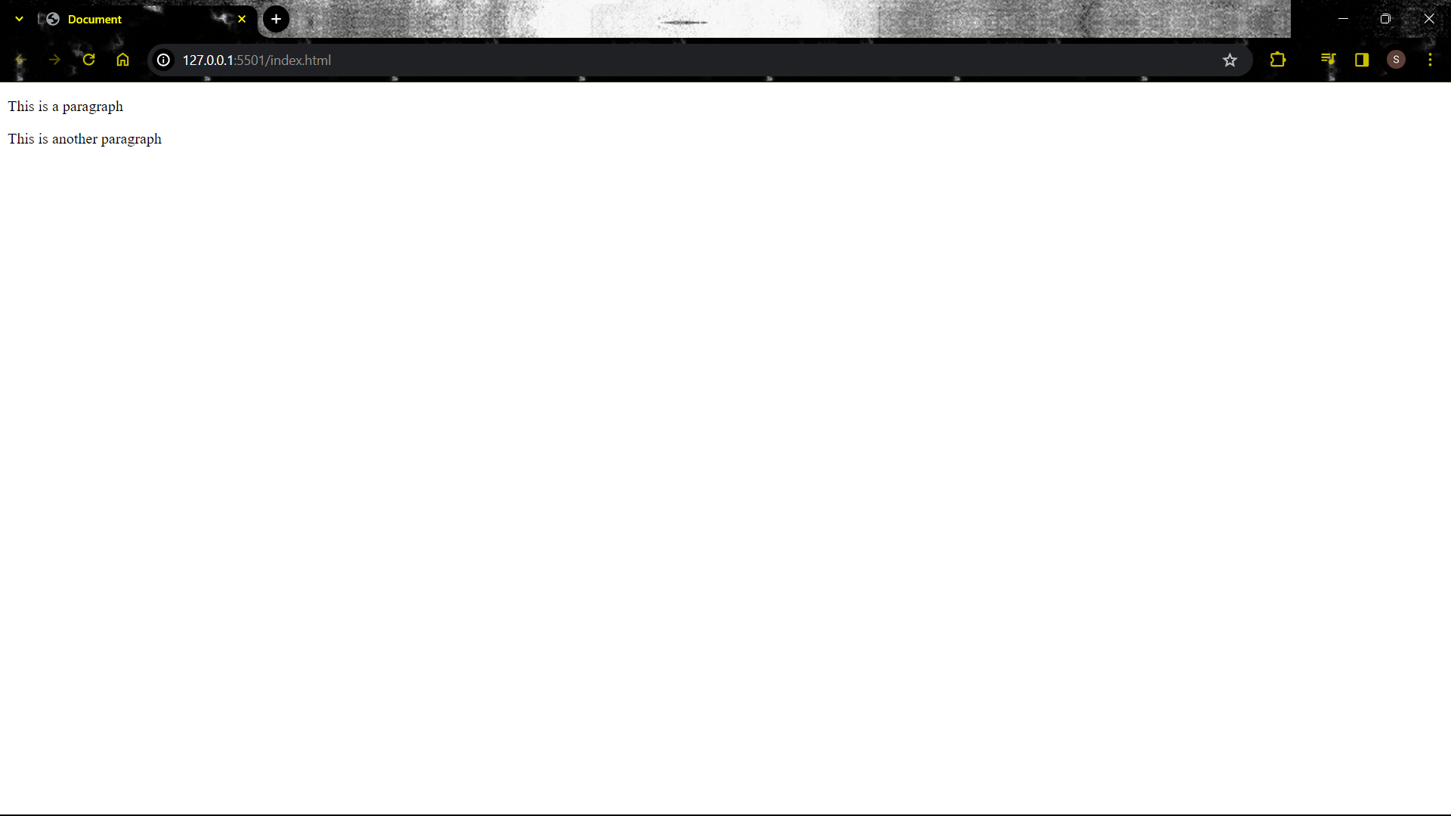
Paragraph Tag: -
<!DOCTYPE html>
<html>
<head>
<title>Document</title>
</head>
<body>
<p>This is a paragraph</p>
<p>This is another paragraph</p>
</body>
</html>

Slide 9
The Anchor Tag: -
The Anchor tag is used to add a link to the existing content inside an HTML page.
<a href="https://www.google.com/">click me!!</a>
The img Tag:-
The img tag is used to add images on the HTML web page.
<img src="image.png" alt="image">
Bold, Italic and Underline Tag: -
We can use the bold, italic, and underline tags to highlight the text.
<b>this bold</b>
<i>this is italic</i>
<u>this is underlined</u>

Slide 10
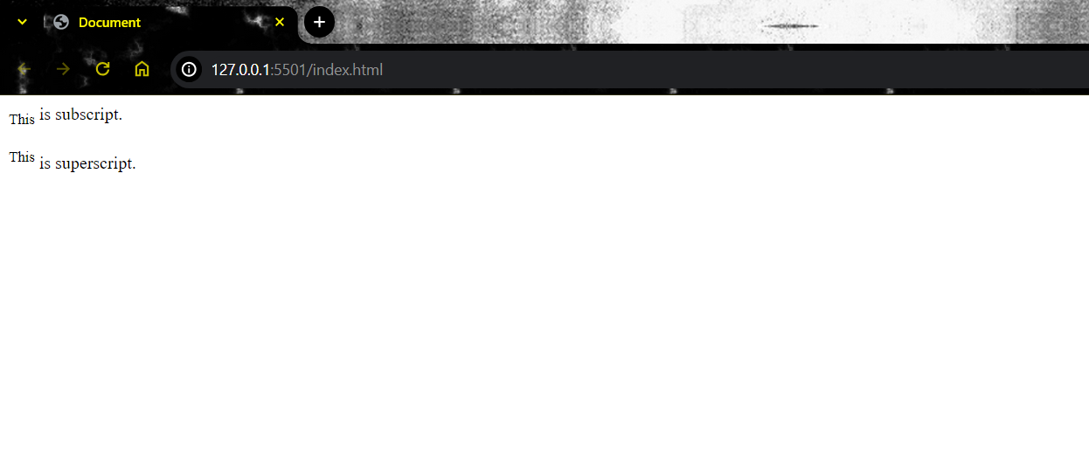
The br Tag: -
The br tag is used to create line breaks in an HTML document.
The hr Tag: -
The hr tag in HTML is used to create a horizontal ruler often used to separate content on HTML page.
The subscript and superscript tag: -
We can add subscript and superscript in HTML as follows.
<!DOCTYPE html>
<html>
<head>
<title>Document</title>
</head>
<body>
<sub>This</sub> is subscript. <br><br>
<sup>This</sup> is superscript.
</body>
</html>

Slide 11
The Marquee Tag: -
The Marquee HTML tag is a non-standard HTML element that is used to scroll an image or text horizontally or vertically.
<marquee>This is marquee tag</marquee>
The div Tag: -
The div tag is often used as a container for other elements. It is a block level element.
Lists: -
There are two types of lists: -
1. Ordered Lists: used to list ordered items.
<ul>
<li>Home</li>
<li>About</li>
</ul>

Slide 12
2. Unordered Lists: used to list unordered items.
<ol>
<li>Phone</li>
<li>PC</li>
<li>Laptop</li>
</ol>
Tables: -
The <table> tag is used to define tables in HTML. It is used to format and display data in tabular form.
tr tag: used to display table row.
td tag: used to display table data.
th tag: used in place of table data to display table headers.
We can define as many table rows as we want. To add a caption to the table, we use <caption> tag inside the table.

Slide 13
<!DOCTYPE html>
<html>
<head>
<title>Document</title>
<style>
table, th, td{
border: 1px solid black;
border-collapse: collapse;
}
td, th{
padding: 5px;
}
</style>
</head>
<body>
<table>
<tr>
<th>Company</th>
<th>Contact</th>
<th>Country</th>
</tr>
<tr>
<td>Alfreds Futterkiste</td>
<td>Maria Anders</td>
<td>Germany</td>
</tr>
<tr>
<td>Centro comercial Moctezuma</td>
<td>Francisco Chang</td>
<td>Mexico</td>
</tr>
</table>
</body>
</html>

Slide 14
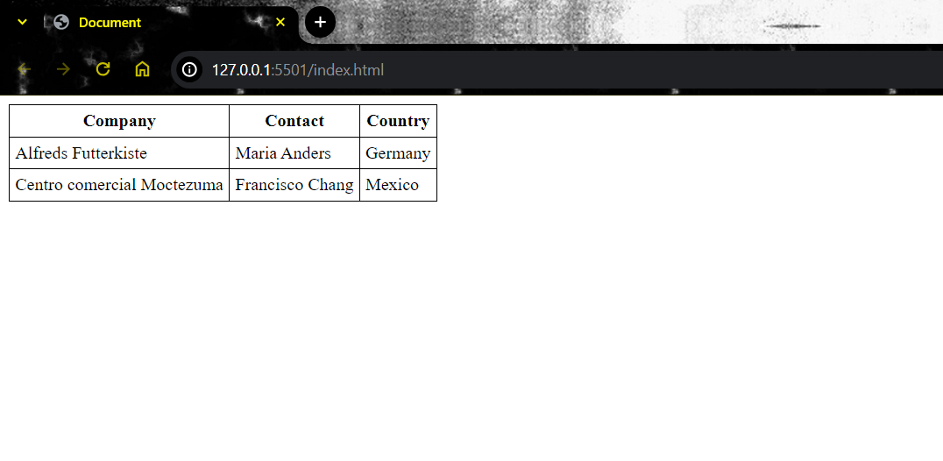
Result

Slide 15
HTML Forms: -
An HTML form is used to collect data from the user and to make a html form,
<form> tag is used.
There are different form elements for different types of user inputs: -
Input element: Can be of type text, checkbox, radio, button, and submit. We also have a “file” type.
Text area: Defines a multi line text input cols and row attributes can be used to size the text area.
Select element: Defines a drop down list.
Buttons: -
<button> tag is used to make clickable button in the html.
Inside a <button> element you can put text (and tags like <i>, <b>, <strong>, <br>, <img>, etc.). That is not possible with a button created with the <input> element!

Slide 16
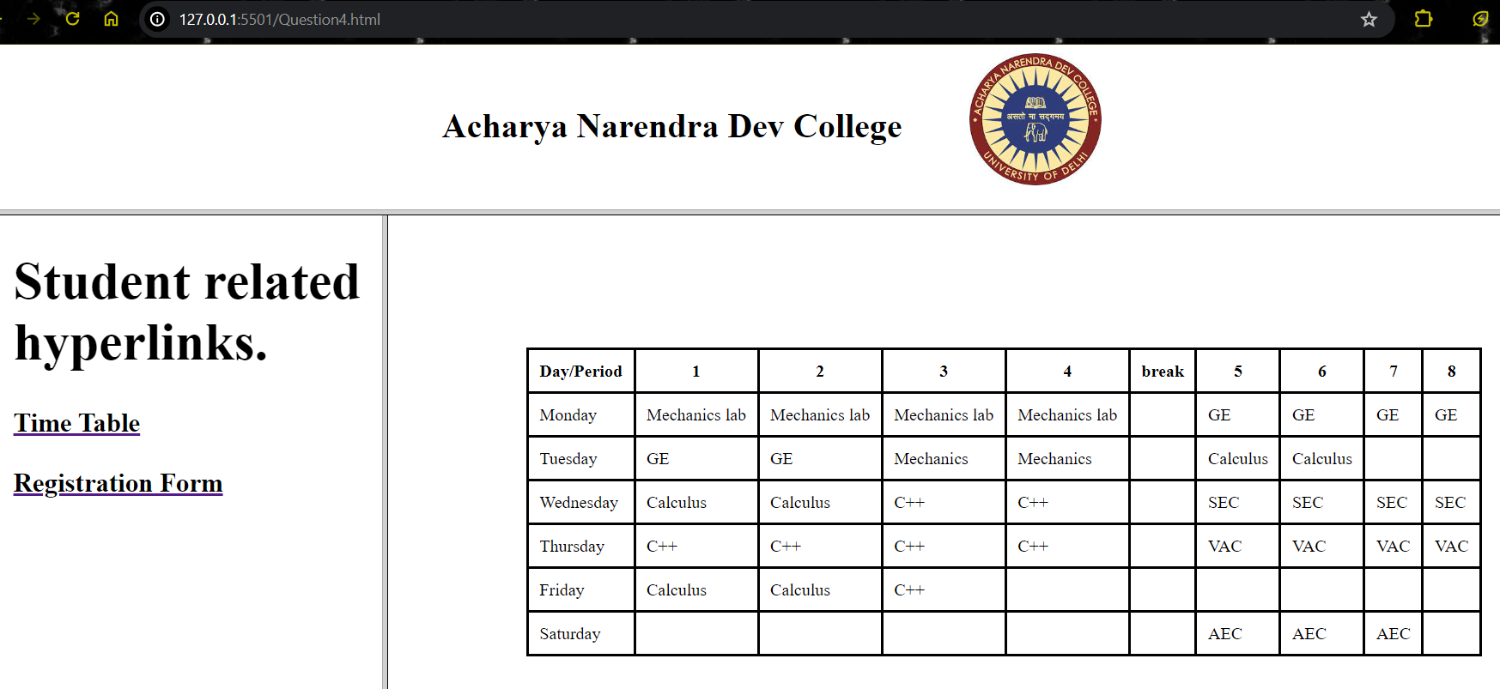
HTML frame and frameset Tags: -
This tag defines a specific window or frame inside the <frameset> tag. Every <frame> within the <frameset> tag may use attributes for different purposes like border, resizing capability, include scrolling, etc. The primary use of these frames was to display a menu in parts of the page with content in one part of the page. Multiple HTML pages can be viewed in a browser window using this tag.
<!DOCTYPE html>
<html> <head>
<title>4</title>
</head> <frameset rows="20%,80%">
<frame src="frame1.html">
<frameset cols="25%,75%">
<frame src="frame2.html">
<frame name="frame3">
</frameset>
</frameset>
</html>

Slide 17

JavaScript
The brain of a webpage.
Why learn Js?
JavaScript is a relatively easy language to learn, and it is supported by all major web browsers. This makes it a popular choice for web development, as it allows developers to create complex and interactive web pages without having to rely on server-side scripting languages.
Also, Js has some really amazing libraries and frameworks like React and Angular that make front-end development easy and fun!!

Slide 18
Variables
What is a variable?
A variable is a container that can store a value. The value of a Js variable can be changed during the execution of a program.
var a = 7;
let a = 7;
Rules for choosing a variable name: -
Letters, digits, underscore and $ sign are allowed.
Can start with a letter, underscore, or $.
Reserved keywords must not be used as the variable names.
It is a case-sensitive language. “NAME” and “name” would be treated as different variable names.
Declaring variable
Assignment operator
identifier

Slide 19
camelCase is preferred while giving names to the variables because of the
case-sensitive nature.
What is camelCase?
When giving a name to the variable we don’t give any space and make the first letter of the second word capital.
for example: -variableName, secondVariable, and moreVariables.
var, let and const: -
var is globally scoped while let and const are block scoped.
var can be updated and re-declared within its scope.
let can be updated but not re-declared.
const can neither be updated nor be re-declared.
var variables are initialized with undefined whereas let
and const are not initialized if not given any value.
const must be initialized at the time of declaration unlike const and let.
Notice that the first letter of the second word is capital. This only is called camelCase.
NOTE: - Scope is the area of a program where a variable or function can be accessed. It's also the area where an item with an identifier name is recognized.

Slide 20
Data Types
There are mainly two types of data type: -
Primitive
Non Primitive.
Primitive Data Types: -
This is a set of basic data types in JavaScript.
There are 7 types of primitive datatypes: -
Null, Number, String, Symbol, Undefined, Boolean, and BigInt.
Non Primitive Data Type: -
An object is a non-primitive data type.
An object in JavaScript can be created as follows: -
const item = { name : “Led Bulb”,
price : “150”
}
NOTE: - Object is a datatype with key and value pairs.
If you know Python then object in Js are same as dictionary in Python.
value
key

Slide 21
Expressions & Conditionals: -
A fragment of code that produces a value is called an expression. Every value written is literally an expression. For example 77 or ‘name’.
Operators in JavaScript: -
Arithmetic Operators.
+ | Addition
- | Subtraction
* | Multiplication
** | Exponentiation
/ | Division
% | Modulus (Remainder)
++ | Increment
-- | Decrement

Slide 22
2 Assignment Operators
Operator | Example | Same As
= | x = y | x = y
+= | x += y | x = x + y
-= | x -= y | x = x - y
*= | x *= y | x = x * y
/= | x /= y | x = x / y
%= | x %= y | x = x % y
**= | x **= y | x = x ** y

Slide 23
3 Comparison Operators
== | equal to | x == 8 | false
 |  | x == 5 | true
 |  | x == "5" | true
=== | equal value and equal type | x === 5 | true
 |  | x === "5" | false
!= | not equal | x != 8 | true
!== | not equal value or not equal type | x !== 5 | false
 |  | x !== "5" | true
 |  | x !== 8 | true
> | greater than | x > 8 | false
< | less than | x < 8 | true
>= | greater than or equal to | x >= 8 | false
<= | less than or equal to | x <= 8 | true

Slide 24
4 Logical Operators
Apart from these we also have type and bitwise operators. Bitwise operators perform bit-by-bit operations on numbers.
Conditional Statements: -
Sometimes we might have to execute a piece of code based on some condition.
Use if to specify a block of code to be executed, if a specified condition is true
Use else to specify a block of code to be executed, if the same condition is false
Use else if to specify a new condition to test, if the first condition is false
Use switch to specify many alternative blocks of code to be executed
Operator | Description | Example
&& | and | (x < 10 && y > 1) is true
|| | or | (x == 5 || y == 5) is false
! | not | !(x == y) is true

Slide 25
Example for if….else if…..else statement: -
if (condition) { // block of code to be executed if the condition is true }
else if(condition) { // block of code to be executed if the first condition is false }
else (condition) { // block of code to be executed if the condition is false }
Example for Switch statement: -
switch(expression) { case x: // code block break; case y: // code block break; default: // code block }

Slide 26
Loops: -
Loops are used to run the same code again and over again with different values.
JavaScript supports different types of loops.
For loop
For in loop
For of loop
While loop
Do while loop
For loop: -
It creates a loop with 3 optional expressions.
for (expression 1; expression 2; expression 3) { // code block to be executed }
Expression 1 is executed (one time) before the execution of the code block.
Expression 2 defines the condition for executing the code block.
Expression 3 is executed (every time) after the code block has been executed

Slide 27
The for-in loop: -
The JavaScript for-in statement loops through the properties of an Object:
for (key in object) { // code block to be executed }
The for of loop: -
The JavaScript for of statement loops through the values of an iterable object.
It lets you loop over iterable data structures such as Arrays, Strings, and more:
for (variable of iterable) { // code block to be executed }
The while loop: -
The while loop loops through a block of code as long as a specified condition is true.
while (condition) { // code block to be executed}

Slide 28
The do while loop: -
The do-while loop is a variant of the while loop. This loop will execute
the code block once, before checking if the condition is true, then it will repeat the loop as long as the condition is true.
do { // code block to be executed } while (condition);
Functions in JavaScript: -
A JavaScript function is a block of code designed to perform a particular task.
Syntax of a function: -
function myfunc(para1, para2, …….){ //code
}
Here parameter behaves as local variables

Slide 29
myfunct(7, 8, …..) function invocation.
Function invocation is a way to use the code inside the function.
A function can also return back a value. The value is returned back to the caller.
Comments in JavaScript: -
Single-line comments start with //.
Multi-line comments start with /* and end with */.
Any text between /* and */ will be ignored by JavaScript
Ways to add Js: -
Using <script></script> tag in the <head> tag or at the bottom of the <body> tag. This is internal JavaScript.
Using the src attribute of <script> tag to include Js using a separate file. This is external JavaScript.
JavaScript can also be executed by giving a piece of code of Js as value to an event attribute. This is called inline Javascript.

Slide 30
Events: -
HTML events are the things that happen to HTML tags. It can be something that a browser does or something the user does and JavaScript can react to these events.
For example: -
An HTML page finished loading.
An HTML input field was entered.
An HTML button was clicked.
JavaScript let’s you execute code when
events are detected.

Slide 31
Common HTML Events: -
For example: -
<button onclick="document.getElementById('demo').innerHTML = Date()">The time is?</button>
Event | Description
onchange | An HTML element has been changed
onclick | The user clicks an HTML element
onmouseover | The user moves the mouse over an HTML element
onmouseout | The user moves the mouse away from an HTML element
onkeydown | The user pushes a keyboard key
onload | The browser has finished loading the page

Slide 32

JavaScript HTML DOM: -
When a web page is loaded, the browser creates a Document Object Model.
The HTML DOM model is constructed as the tree of objects:

Slide 33
With the object model, JavaScript gets all the power it needs to create dynamic HTML:
JavaScript can change all the HTML elements on the page.
JavaScript can change all the HTML attributes on the page.
JavaScript can change all the CSS styles on the page.
JavaScript can remove existing HTML elements and attributes.
JavaScript can add new HTML elements and attributes.
JavaScript can react to all existing HTML events on the page.
JavaScript can create new HTML events on the page.
In other words: The HTML DOM is a standard for how to get, change, add, or delete HTML elements.

Slide 34
Js HTML DOM Methods: -
HTML DOM methods are actions you can perform (on HTML Elements).
HTML DOM properties are values (of HTML Elements) that you can set or change.
The HTML DOM can be accessed with JavaScript (and with other programming languages).
In the DOM, all HTML elements are defined as objects.
The programming interface is the properties and methods of each object.
A property is a value that you can get or set (like changing the content of an HTML element).
A method is an action you can do (like add or deleting an HTML element).

Slide 35
Example: -
<html> <body> <p id="demo"></p> <script> document.getElementById("demo").innerHTML = "Hello World!"; </script> </body> </html>
In the example above, getElementById is a method, while innerHTML is a property.
The getElementById Method: -
The most common way to access an HTML element is to use the id of the element. In the example above the getElementById method used id="demo" to find the element.

Slide 36
The innerHTML Property: -
The easiest way to get the content of an element is by using the innerHTML property.
The innerHTML property is useful for getting or replacing the content of HTML elements.
The HTML DOM Document Object: -
The document object represents your web page.
If you want to access any element in an HTML page, you always start with accessing the document object.
Below are some examples of how you can use the document object to access and manipulate HTML.
Finding HTML Elements
Method | Description
document.getElementById(id) | Find an element by element id
document.getElementsByTagName(name) | Find elements by tag name
document.getElementsByClassName(name) | Find elements by class name

Slide 37
Property | Description
element.innerHTML = new html content | Change the inner HTML of an element
element.attribute = new value | Change the attribute value of an HTML element
element.style.property = new style | Change the style of an HTML element
Method | Description
element.setAttribute(attribute, value) | Change the attribute value of an HTML element
Changing HTML Elements

Slide 38
Changing HTML Style: -
To change the style of an HTML element, use this syntax:
document.getElementById(id).style.property = new style
The following example changes the style of a <p> element:
<html> <body> <p id="p2">Hello World!</p> <script> document.getElementById("p2").style.color = "blue"; </script> </body> </html>

